Slide 1
The Impact of Continuous Integration on Other Software Development Practices: A Large-Scale Empirical Study
Zhao, Serebrenik, Zhou, Filkov, & Vasilescu
Adrienne Grieco, Matt Irwin, & Ellery Baines

Slide 2


Where does CI fit into DevOps?
Pre-commit Tests
Pre-commit Tests
Commit
Commit
Build and Integration Tests
Build and Integration Tests
UAT/Staging/Performance Tests
Deploy to Production
Promote
to Normal Production
Commit
Pre-commit Tests
Commit
Pre-commit Tests
Bass, L., Weber, I., Liming, Z. (2015). DevOps: A Software Architect’s Perspective. New York: Addison-Wesley Professional
Notes:
Integrating the operations process into development - automation throughout deployment pipeline (dependent on a strong code infrastructure for testing, the works) Implications for dramatic change (not only in practices) but organization, team size, and architecture…
CI is only the first part of this pipeline: focus on merging developer commits into a successful build

Slide 3
Continuous Integration (based on Martin Fowler’s definition)
A fully automated build and test process intended to ease the process of code integration within developer teams.
Best practices?
Expectations?
Pre-commit Tests
Commit
Commit to the mainline every day
Fix broken builds immediately
Keep the build fast
Build and Integration Tests
Pre-commit Tests
Commit
More frequent and smaller commits
Faster problem resolution
Increase in automated tests
Notes:
Use version control systems for a start.
Working in teams can cause merge conflicts, and the bigger the code change, the harder these issues can be to resolve so...
Commit to the mainline every day
Once code is committed, make sure it builds, if there are errors…
Fix broken builds immediately
This should be a routine process
Keep the build fast
Working in teams can cause merge conflicts, and the bigger the code change, the harder these issues can be to resolve
“Broken build” - part of the build are tests that make sure the code is still valid, no new bugs are introduced (self testing code is a best pratice too!)

Slide 4


Monitoring the Effects of Continuous Integration
Monitoring trends before and after the adoption of Travis CI
575 open source projects found on GitHub
All adopted and actively used TRAVIS CI
How representative of CI practices is the adoption of Travis CI?
Survey: What made developers decide to use Travis CI?
“...contributors couldn’t be trusted to run [the] test suite on their own”
This adopts CI
“...part of [an] automated package/release effort”
This doesn’t...
Notes:
Paper is expecting to monitor the effects of Continuous Integration on project development… by using a tool that can be used with integration
Tool != CI --- they’re looking at a wide spectrum
“Our findings suggest a more nuanced picture of how GITHUB teams are adapting to, and benefiting from, continuous integration technology than suggested by prior work.”

Slide 5

Pre-commit Tests
Commit
Build and Integration Tests
UAT/Staging/Performance Tests
Deploy to Production
Pre-commit Tests
Commit
Bass, L., Weber, I., Liming, Z. (2015). DevOps: A Software Architect’s Perspective. New York: Addison-Wesley Professional
Notes:
You are here: Monitoring the adoption of a tool that may or may not imply the adoption of CI.

Slide 6
Research Questions
RQ1: Are developers committing code more frequently?
RQ2: Are developers reducing the size of code changes in each commit post CI adoption? Do they continue to do so over time?
RQ3: Are pull requests closed more quickly post CI adoption?
RQ4: Are more issues being closed after adopting CI?
RQ5: How does the usage of automated testing change over time after CI adoption?

Slide 7
Methods
Collected and analyzed a large number of open source GitHub projects
Non-Trivial projects that adopted Travis CI and had sufficient activity before and after adaptation
Identified 165,594 projects that use Travis CI
Found the appearance of Travis CI and studied the 12 month periods before and after Travis adoption
Filtered it down to the 575 most active
Math Math Math...

Slide 8
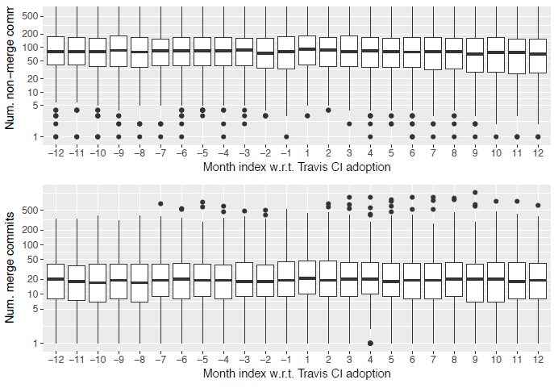
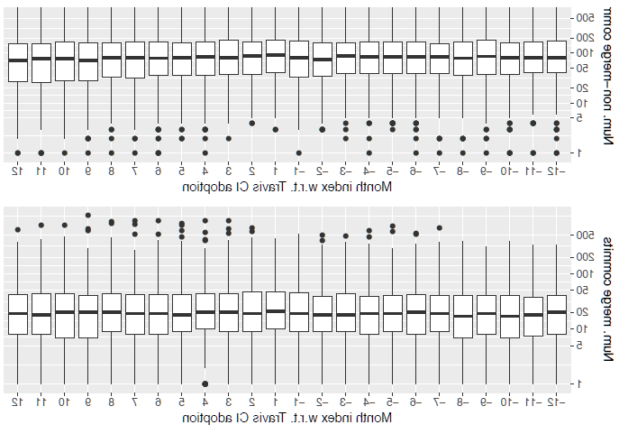
Results
?
Commit frequency before and after the TRAVIS CI adoption.

Slide 9
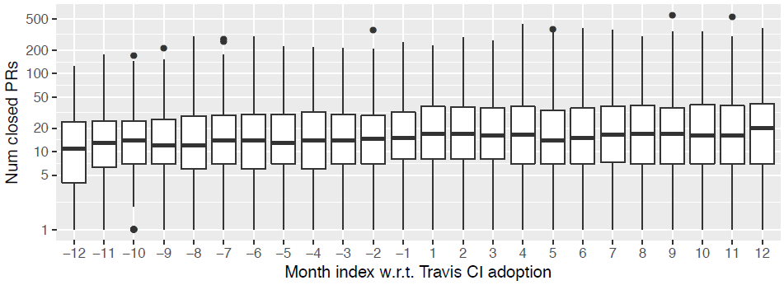
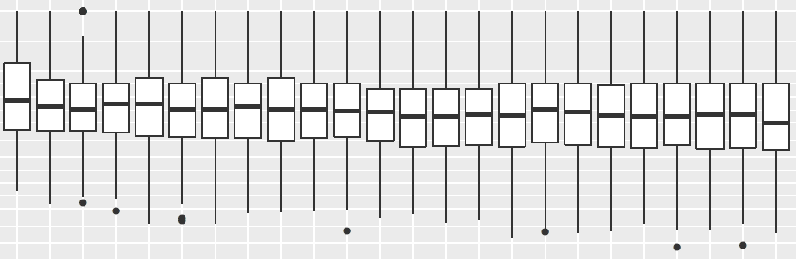
Results
?
Closed pull requests before and after the TRAVIS CI adoption

Slide 10
Results
RQ1: Are developers committing code more frequently?
The exploratory study suggests a slight decreasing trend in the rate of non-merge commits with time.
RQ2: Are developers reducing the size of code changes in each commit post CI adoption? Do they continue to do so over time?
Results suggest that while Fowler’s good practice of small commits is followed to some extent, the project-to-project and language-to-language differences are more important and might overshadow the overall trend.

Slide 11
Results con’t
RQ3: Are pull requests closed more quickly post CI adoption?
Surprisingly, no striking change
RQ4: Are more issues being closed after adopting CI?
The number of issue closed actually slows down after CI adoption
RQ5: How does the usage of automated testing change over time after CI adoption?
test suite increases...

Slide 12
Validity
Merge vs non-merge commits to the main branch
Project life cycle
IMHO, YAML: IDK?
Spurious correlations
Distributed branch work
Notes:
Zhao et al. reported that for OSS GitHub projects, after the adoption of CI tools:
The number closed issues increases.
The frequency and size of commits increases.

Slide 13
Further Research
Continuous Integration: The Silver Bullet? ~ Rahman et al.
Found similar results but concluded that the changes in behavior were not significant
“...with respect to the development process, proprietary projects have fundamental differences with OSS projects”
Advice: avoid the cargo cult
consider the teams’ development context
systematically assess, to what extent other practitioners’ experiences hold
Rahman, A., Agrawal, A., Krishna, R., Sobran, A., Menzies, T. (2017). Continuous Integration: The Silver Bullet?. Nov. 2017 arXiv:1711.03933.
Notes:
Zhao et al. reported that for OSS GitHub projects, after the adoption of CI tools:
The number closed issues increases.
The frequency and size of commits increases.

Slide 14



What does it all mean!?
Is Travis CI the best CI?
Resource restrictions
Github integrated
Alternatives:
Jenkins & Circle
Is CI the future?
Shows better success for open source projects
Better for issue resolution than bug resolution
Influences collaboration

Slide 15

Questions?

Slide 16
Citations
Bass, L., Weber, I., Liming, Z. (2015). DevOps: A Software Architect’s Perspective. New York: Addison-Wesley Professional; 1 edition (May 28, 2015).
Fowler, M. (2000) Continuous Integration (original version). (n.d.). Retrieved February 2018, from https://martinfowler.com/articles/originalContinuousIntegration.html
Rahman, A., Agrawal, A., Krishna, R., Sobran, A., Menzies, T. (2017). Continuous Integration: The Silver Bullet?. Nov. 2017 arXiv:1711.03933. http://adsabs.harvard.edu/abs/2017arXiv171103933R.
Zhao, Y., Serebrenik, A., Zhou, Y., Filkov, V., & Vasilescu, B. (2017). The impact of continuous integration on other software development practices: A large-scale empirical study. 2017 32nd IEEE/ACM International Conference on Automated Software Engineering (ASE).

